Slide 1

CS1011 Computer Programming in Python
Lecture 3:Loops (For and While)

Slide 2
Objectives
• Introduction to loops:
`for` and `while` loops
• Using `range()` with `for` loops
• Infinite loops and loop control with `break`, `continue`, and `else`

Slide 3
Loops
A loop lets you run the same section of code over and over again until a specific condition is met
In python, we have looping statements such as:
While
for

Slide 4
Loops: While
  It loops through a section of code as long as the specified condition is true.
The indefinite or conditional loop keeps iterating until certain conditions are met.
while <condition>:
<body>
condition is a Boolean expression, just like in if statements. The body is a sequence of one or more statements.
Semantically, the body of the loop executes repeatedly as long as the condition remains true. When the condition is false, the loop terminates.

Slide 5
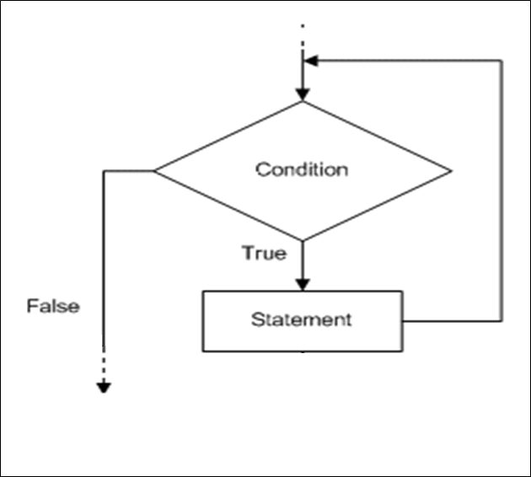
Loops: while
The condition is tested at the top of the loop. This is known as a pre-test loop. If the condition is initially false, the loop body will not execute at all.

Slide 6
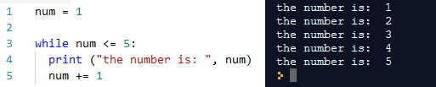
Indefinite Loop while (example)
  Print the numbers 1-5 proceeded with the sentence "the number is: " using a while loop

Slide 7
Loops: while (example)
n = 5
Program:
n = 5
while n > 0 :
print(n)
n = n – 1
print('Blastoff!')
print(n)
Output:
5
4
3
2
1
Blastoff!
0
No
n > 0 ?
Yes
print(n)
n = n -1
Loops (repeated steps) have iteration variables that change each time through a loop. Often these iteration variables go through a sequence of numbers.
print('Blastoff')

Slide 8
For Loops
The for loop is a definite loop, meaning that the number of iterations is determined when the loop starts.
We can’t use a definite loop unless we know the number of iterations ahead of time.
The for statement allows us to iterate through a sequence of values.
for <var> in <sequence>:
<body>
The loop index variable var takes on each successive value in the sequence, and the statements in the body of the loop are executed once for each value.

Slide 9
For Loops
  It is used to loop through a set of code a specified number of times
  The range() function determines the sequence of numbers, starting from 0 (default), and ends at a specified number
  It is possible to specify the starting value instead of 0
  Syntax:
  for index in range(sequence):
  statement(s) to be executed

Slide 10
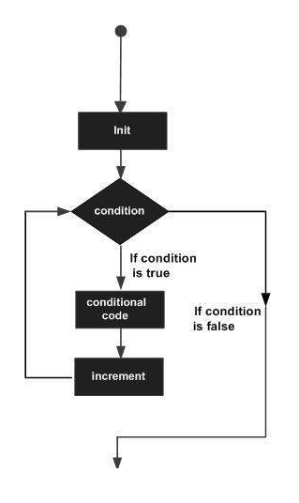
Loops: for

Slide 11
Definite Loop: For Loop — Iterating Through a Sequence
Yes
Done?
No
Move i ahead
5
4
3
2
1
Blastoff!
for i in [5, 4, 3, 2, 1] :
print(i)
print('Blastoff!')
print(i)
Definite loops (for loops) have explicit iteration variables that change each time through a loop. These iteration variables move through the sequence or set.
print('Blast off!')

Slide 12
Looking at in...
The iteration variable “iterates” through all of the values in the sequence
The block (body) of code is executed once for each value in the sequence
Five-element sequence
Iteration variable
for i in [5, 4, 3, 2, 1] :
print(i)

Slide 13
i = 5
No
Yes
Done?
print(i)
Move i ahead
i = 4
print(i)
print(i)
i = 3
print(i)
i = 2
for i in [5, 4, 3, 2, 1] :
print(i)
print(i)
i = 1
print(i)

Slide 14
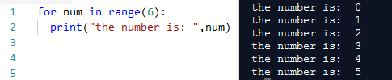
Definite Loop Example: For Loop with range()
  Print the numbers 0-5 proceeded with the sentence "the number is: " using a for loop

Slide 15
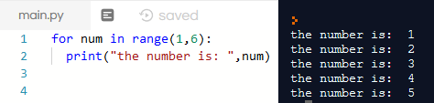
Definite Loop Example: For Loop with range()
  Print the numbers 1-5 proceeded with the sentence "the number is: " using a for loop

Slide 16
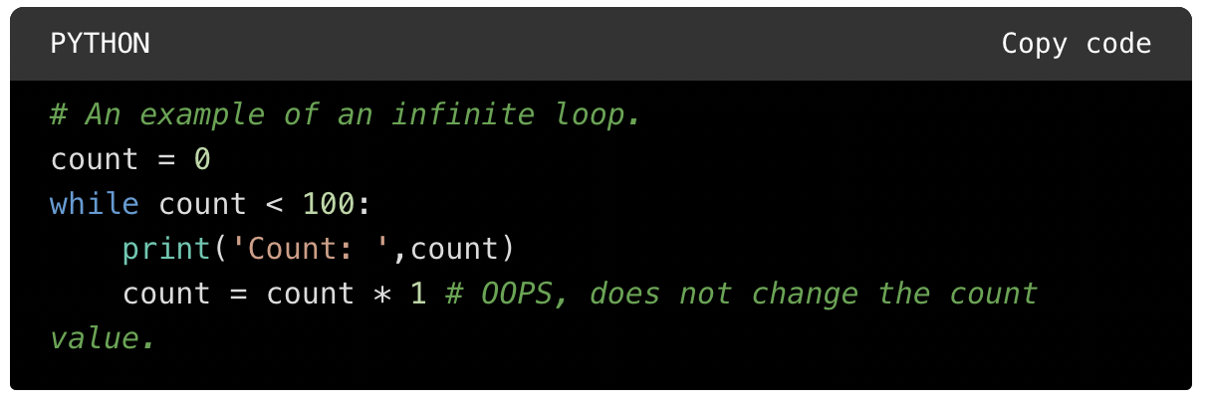
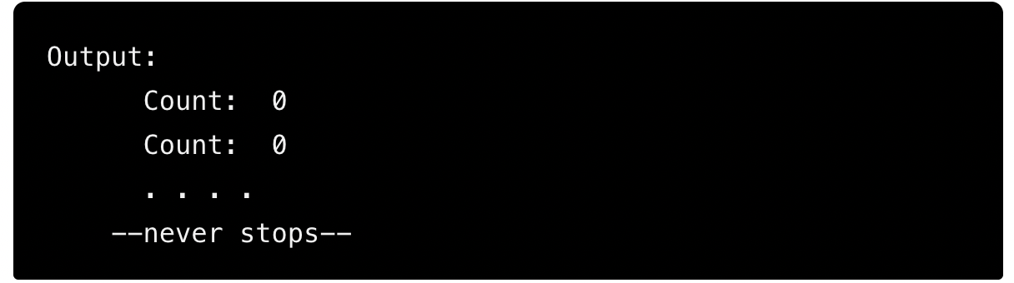
Infinite Loop
An infinite loop (also called endless loop) in Python is a sequence of statements in a program which executes endlessly.
It occurs when the loop condition always evaluates to true. In other words, a loop becomes an infinite loop if a loop condition never becomes false.

Slide 17
loop control :
The break & continue Statement
The break statement can stop the loop even if the condition is true
The continue statement can stop the current iteration, and continue with the next

Slide 18
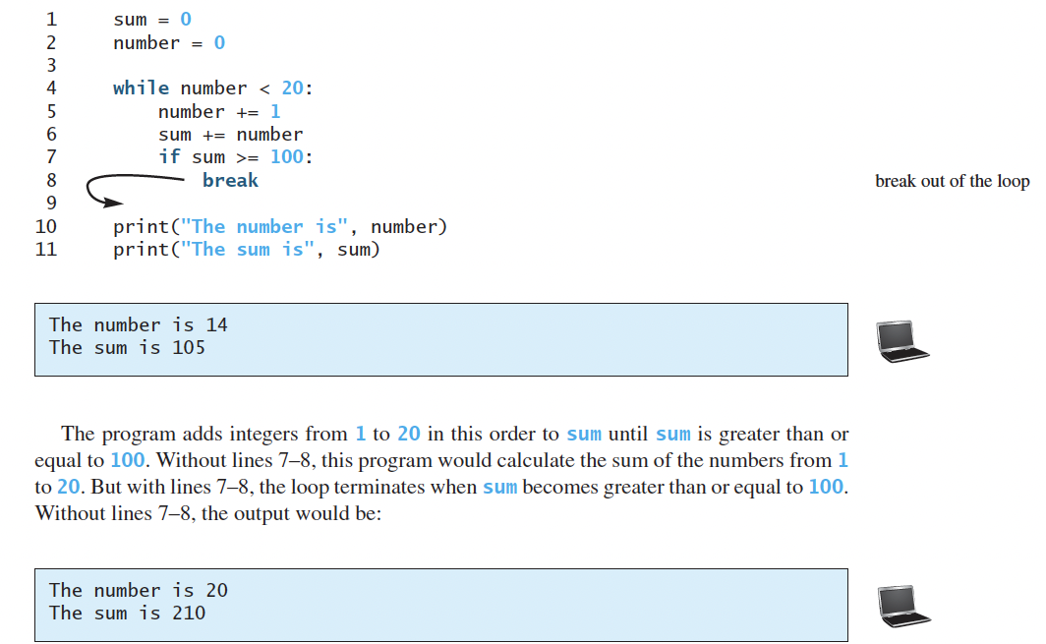
Breaking Out of a Loop
The break statement ends the current loop and jumps to the statement immediately following the loop
It is like a loop test that can happen anywhere in the body of the loop

Slide 19
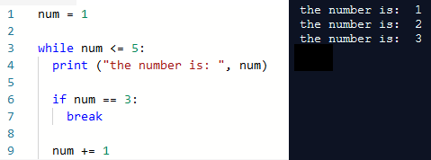
While Loop with Break
  Exit the loop after printing number 3

Slide 20
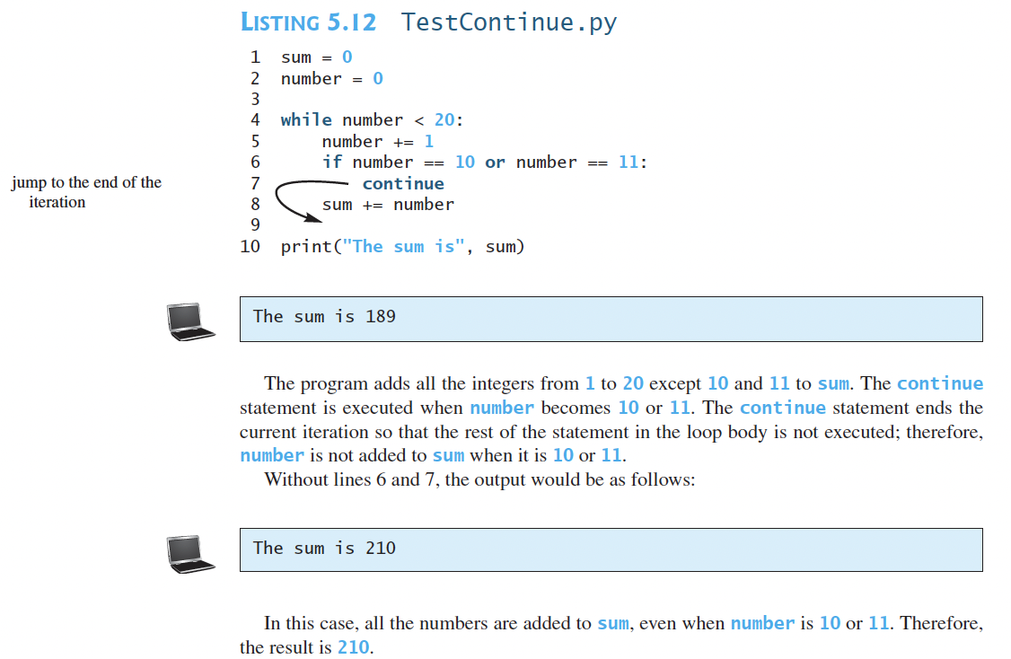
Finishing an Iteration with continue
The continue statement ends the current iteration and jumps to the top of the loop and starts the next iteration.

Slide 21
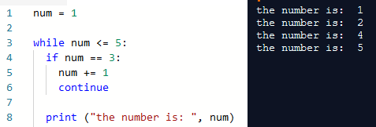
While Loop with Continue
  Skip printing number 3

Slide 22
else Clauses on Loops
In a for or while loop the break statement may be paired with an else clause. If the loop finishes without executing the break, the else clause executes.
In a for loop, the else clause is executed after the loop finishes its final iteration, that is, if no break occurred.
In a while loop, it’s executed after the loop’s condition becomes false.
In either kind of loop, the else clause is not executed if the loop was terminated by a break.

Slide 23
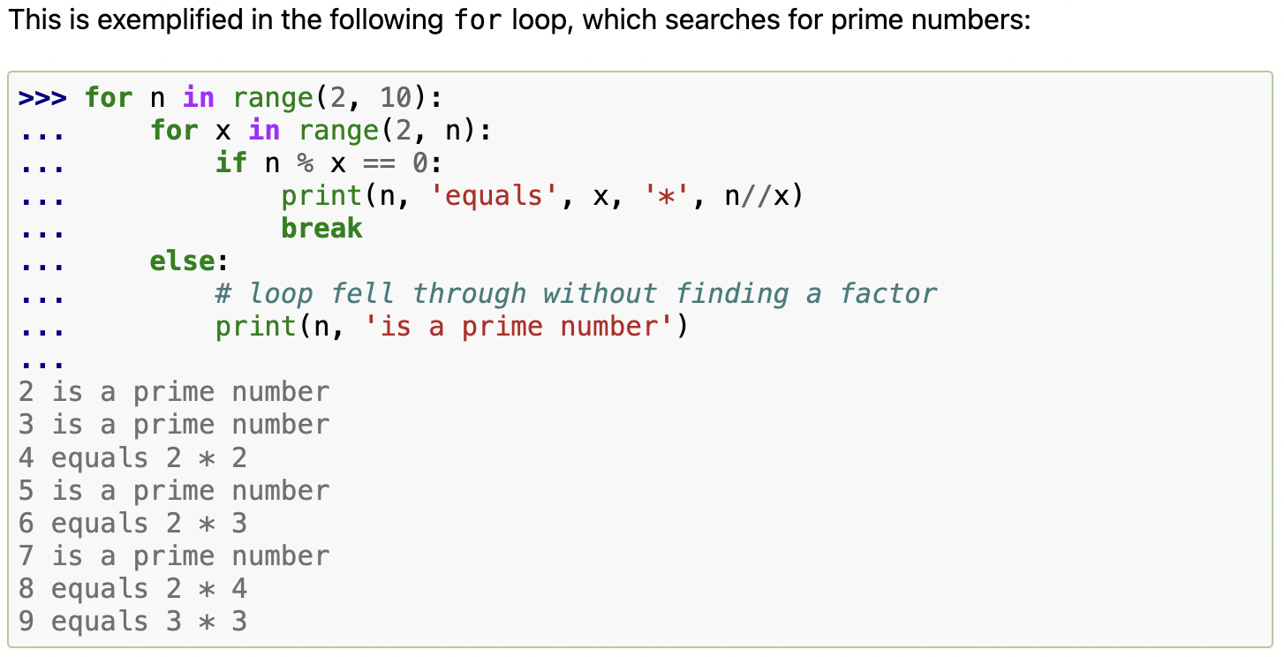
else Clauses on Loops

